Slide 1

High Impact Skills Development Program
in Artificial Intelligence, Data Science, and Blockchain
Module 1: AI Fundamentals
Support Vector Machines - I
Instructors: Dr Latif Anjum / Dr Riaz Ud Din
NUST – SEECS

Slide 2
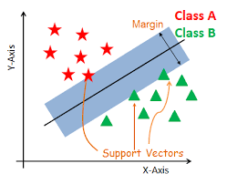
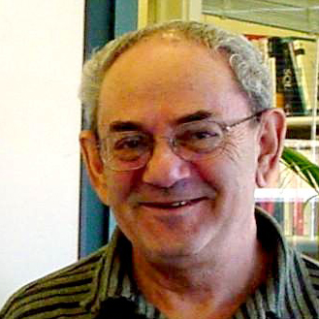

Invention of Support Vector Machines
Margin based classifiers 1995
Vladimir Vapnik
U Columbia

Slide 3
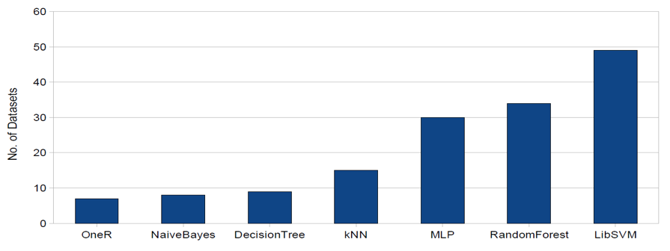
State-of-the-Art Classifiers
A classifier benchmarking experiment
103 datasets, 7 state-of-the-art classifiers

Slide 4
Support Vector Machine (SVM)
SVM is a non-probabilistic binary linear classifier
Proposed by Vladimir Vapnik in 1995
Made popular by Bernhard Schölkopf
Solve a simple optimization problem

Slide 5

Linear Classifiers

Slide 6
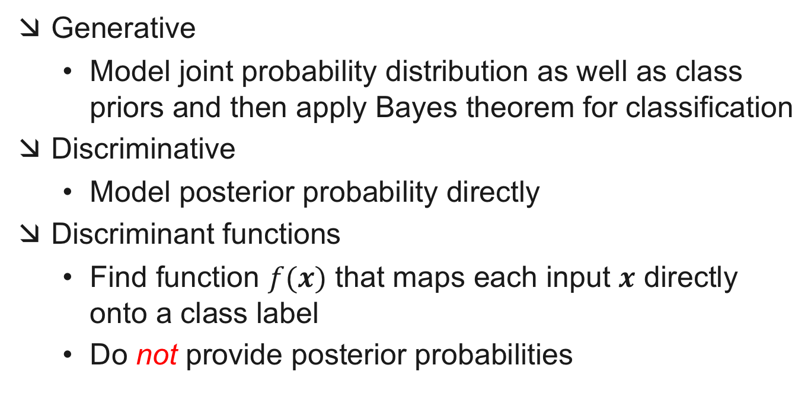
Types of Classification Models
Generative
Model joint probability distribution as well as class priors and then apply Bayes theorem for classification
Discriminative
Model posterior probability directly
Discriminant functions
Find function $f(x)$ that maps each input $x$ directly onto a class label
Do not provide posterior probabilities

Slide 7
Types of Classifiers
Discriminant Functions
Discriminative
Generative

Slide 8
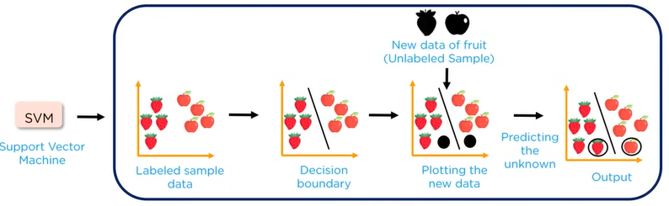
Support Vector Machines

Slide 9
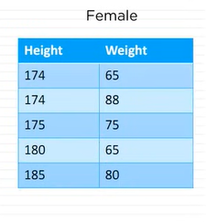
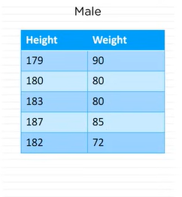
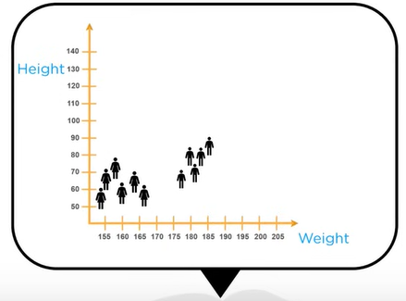
Support Vector Machines

Slide 10
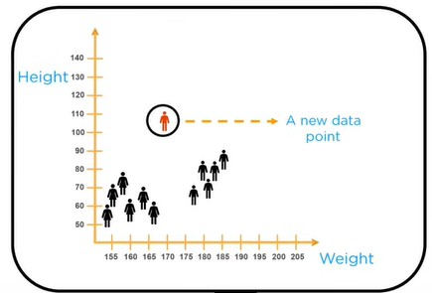
Support Vector Machines

Slide 11
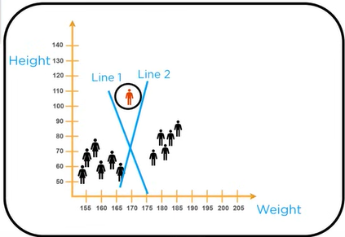
Support Vector Machines

Slide 12
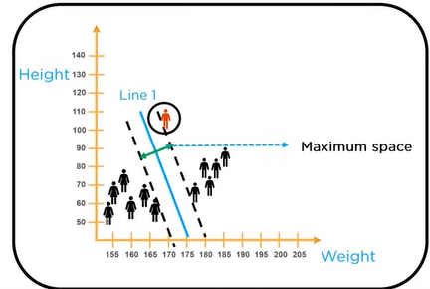
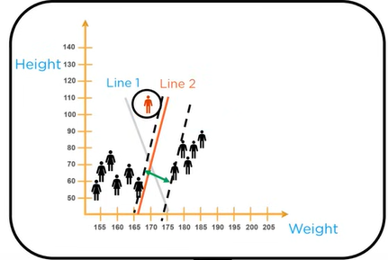
Support Vector Machines

Slide 13
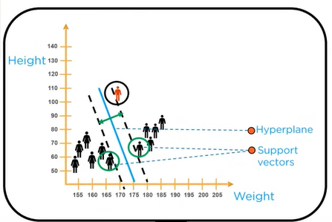
Support Vector Machines

Slide 14
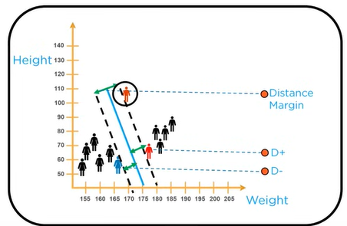
Support Vector Machines | Optimal Hyperplane

Slide 15
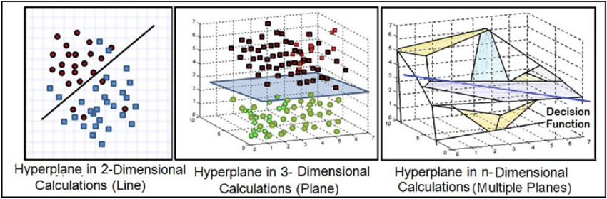
Support Vector Machines | Optimal Hyperplane

Slide 16
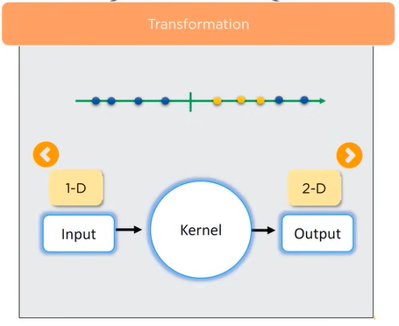
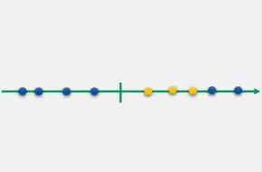
Support Vector Machines | Concept of Kernel

Slide 17
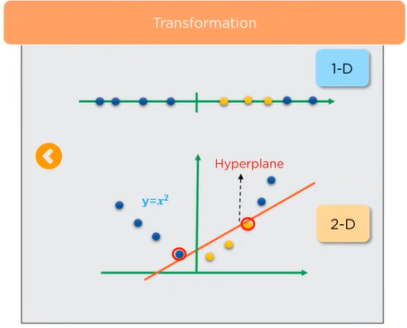
Support Vector Machines | Concept of Kernel

Slide 18
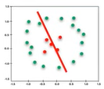
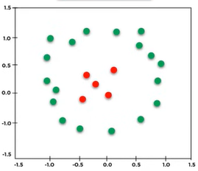
Support Vector Machines | Concept of Kernel

Slide 19
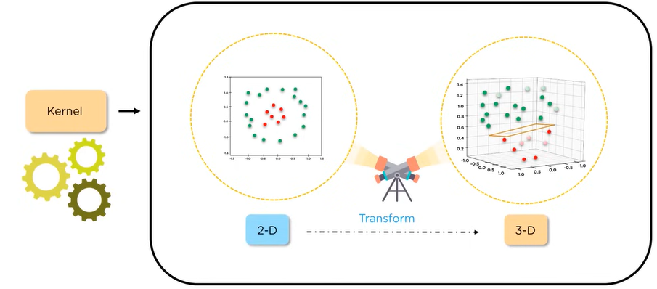
Support Vector Machines | Concept of Kernel

Slide 20
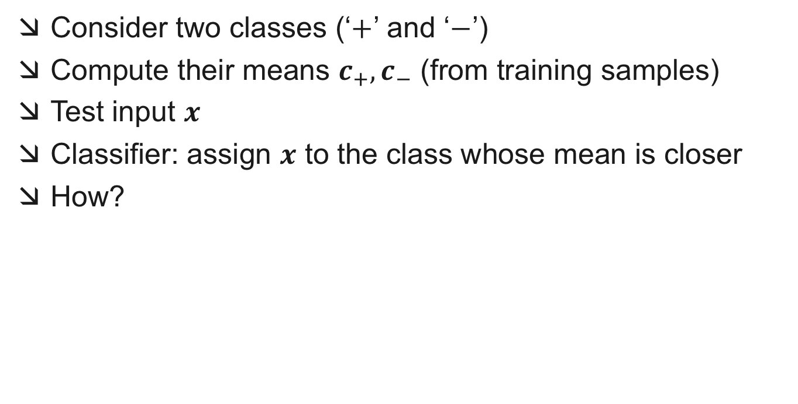
A Simple Linear Classifier
Consider two classes (‘$+$’ and ‘$−$’)
Compute their means $c_{+},c_{−}$ (from training samples)
Test input $x$
Classifier: assign $x$ to the class whose mean is closer
How?
Linear Discriminant Analysis (LDA)

Slide 21

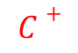
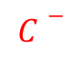

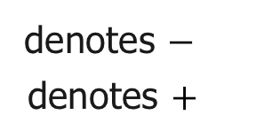
Linear Discriminant Functions
Decision Boundary
$$C−$$
Q2
Centroids
$$w$$
$$C$$
Q1
Middle point between C⁺ and C⁻
Q3
Q4
$$C+$$
denotes $−$
denotes $+$

Slide 22
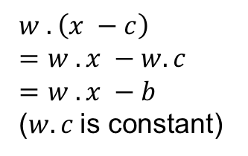
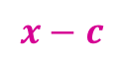

Linear Discriminant Functions
$$C−$$
$$w$$
$$w . \left(x −c\right)$$
$$=w . x −w. c$$
$$=w . x −b$$
($w. c$is constant)
$$C$$
$$x−c$$
$$C+$$
Data Point
$$x$$
denotes $−$
denotes $+$

Slide 23
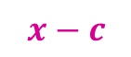

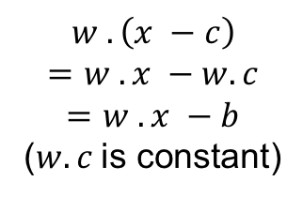
Linear Discriminant Functions
$$C−$$
$$w$$
$$w . \left(x −c\right)$$
$$=w . x −w. c$$
$$=w . x −b$$
($w.c$is constant)
$$x−c$$
$$C$$
$$x$$
$$C+$$
denotes $−$
denotes $+$

Slide 24


Linear Discriminant Functions
$$C−$$
$$w$$
$$x−c$$
$$w . \left(x −c\right)$$
$$=w . x −w. c$$
$$=w . x −b$$
($w.c$is constant)
$$C$$
$$x$$
$$C+$$
denotes $−$
denotes $+$

Slide 25
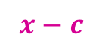

Linear Discriminant Functions
$$x$$
$$C−$$
$$x−c$$
$$w$$
$$w . \left(x −c\right)$$
$$=w . x −w. c$$
$$=w . x −b$$
($w.c$is constant)
$$C$$
$$C+$$
denotes $−$
denotes $+$

Slide 26
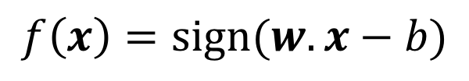
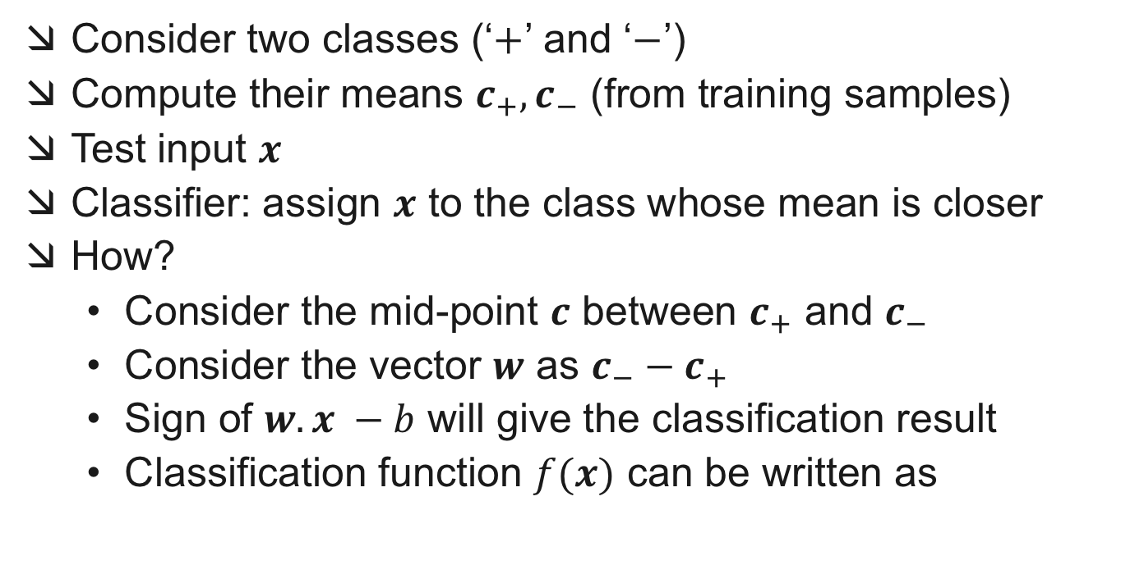
A Simple Linear Classifier
Consider two classes (‘$+$’ and ‘$−$’)
Compute their means $c_{+},c_{−}$ (from training samples)
Test input $x$
Classifier: assign $x$ to the class whose mean is closer
How?
Consider the mid-point $c$ between $c_{+}$ and $c_{−}$
Consider the vector $w$ as $c_{−}−c_{+}$
Sign of $w.x −b$ will give the classification result
Classification function $f(x)$ can be written as
$$f\left(x\right)=sign(w.x−b)$$

Slide 27
X
f
_{y}est
How would you classify this data?
denotes $−$
denotes $+$

Slide 28
X
f
_{y}est
Any of these would be fine..
..but which is best?
denotes $−$
denotes $+$

Slide 29
α
Classifier Margin?
X
f
_{y}est
Define the margin of a linear classifier as the width that the boundary could be increased by before hitting a datapoint.

Slide 30
α
Maximum Margin
X
f
_{y}est
The maximum margin linear classifier is the linear classifier with the, um, maximum margin.
This is the simplest kind of SVM (Called an LSVM)
Support Vectors are those datapoints that the margin pushes up against.
Intuitively this feels safest.
If we’ve made a small error in the location of the boundary (it’s been jolted in its perpendicular direction) this gives us least chance of causing a misclassification.
Empirically it works very very well.
Linear SVM

